Slide 1

2026 Scouting America longhouse council popcorn

Slide 2


Agenda
Meet the Team
Products
Register with Pecatonica River
Where to find info & resources
Proven Methods
Incentive
Policies & Dates
Questions

Slide 3
Council Popcorn Committee
Council Kernel: Karie Cottrell
Committee Member: Deb Curle
Towpath Kernel: Holly Mingolelli
Seaway Trails Kernel: Aubrey Trickey
Accounting: Cindy Barrus
Staff Advisor: Ron ”Papa Bear” Hill
Mascot: Rex

Slide 4
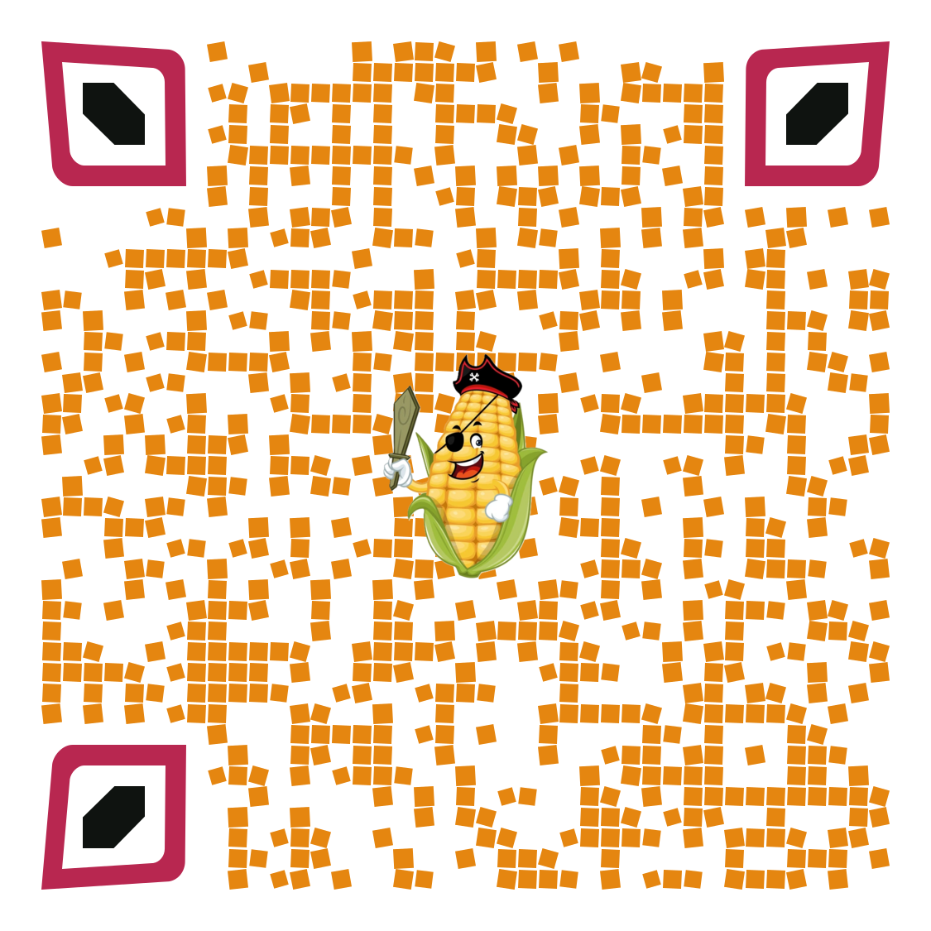

JOIN OUR SWAP GROUP

Slide 5
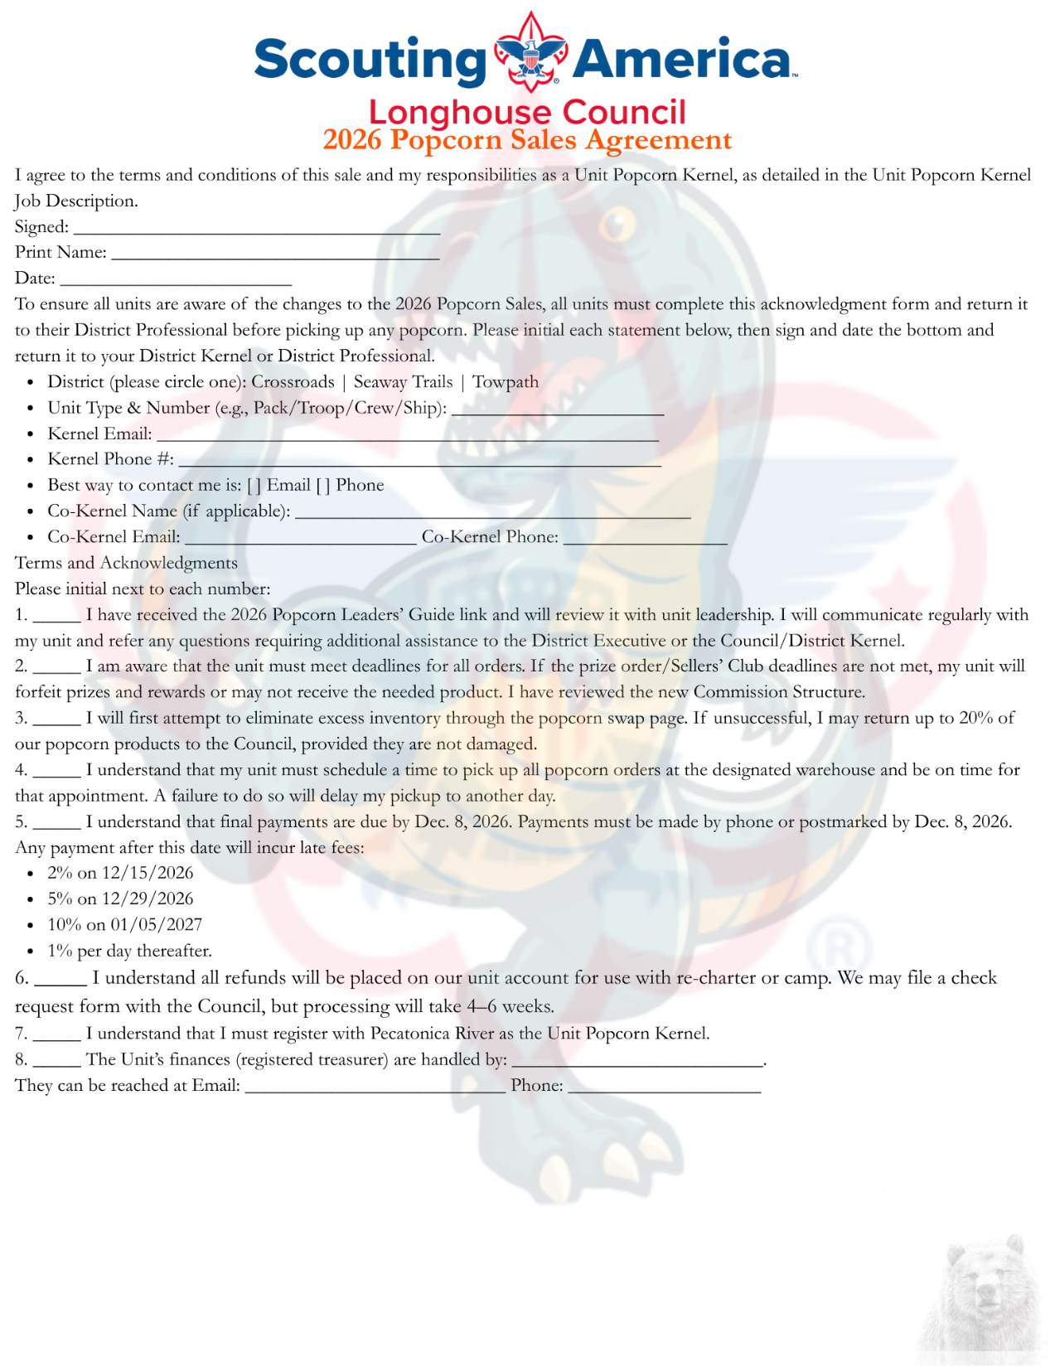

All Units must turn in a sales agreement before receiving any product

Slide 6
Pecatonica River popcorn
Caramel Sea Salt
Sea Salt Splash
Peanut Butter Cup
Mountain Munch
Freedom Pretzels
Classic Trio
Cheese Lovers
Chocolate Lovers
Military Donations
Classic Caramel
Yellow Popcorn
Butter Microwave
Kettle Corn Microwave
Cinnamon Roll
Cheddar Cheese
Jalapeno Cheese
Trail Mix

Slide 7

Pecatonica River Information
• Scout Boss: Create unit profile! Use to place the unit orders, register Scouts, and view sales.
• Kernel Tracker: Unit inventory, web-based, located in Scout Boss dashboard (requires login).
• My PR Popcorn: Scout online selling tool. After the leader adds the Scout, the parent receives an email to register and create a Scout profile.
• www.pecatonicariverpopcorn.com/training-videos
• All links and information on www.cnyscout.org/popcorn
FB Swap page

Slide 8

Units
Ability to remove a scout from a show-n-sell location
Ability to limit the number of scouts that can sign up for a show-n-sell shift
Ability to close a show-n-sell location
The ability to distribute show-n-sell dollars to all scouts automatically
The ability for the Kernel to edit sales amounts
The ability for the Kernel to toggle between multiple profiles
The ability to make unit-to-unit product transfers
All Users
A simplified login page
  The landing page will ask the user if they are accessing
    Myprpopcorn
    Kernel Tracker
    Scout Boss
  At which point directing them to correct login page
TECHNOLOGY

Slide 9

Important Dates
August 1^{st:} Online opens
August 5^{th:} Early Bird order due
August 28th: Pickup @ Warehouse TBD
September 11^{th:} Show-n-Sell order due
September 23rd: 20% payment due
Sept. 25^{th:} Pick up @ Warehouse TBD
October 7th: Show-n-sell order #2 due
October 14^{th:} 20% payment due
October 15^{th:} Pick up @ Warehouse
October 26^{th -} 29^{th:} Returns Due
October 30^{th:} Take order due
November 11^{th:} All numbers due by NOON
Nov. 11^{th:} Balance due on all show-n-sell orders
Nov 13^{th:} Pick up @ Warehouse
December 1^{st:} Prize orders due

Slide 10


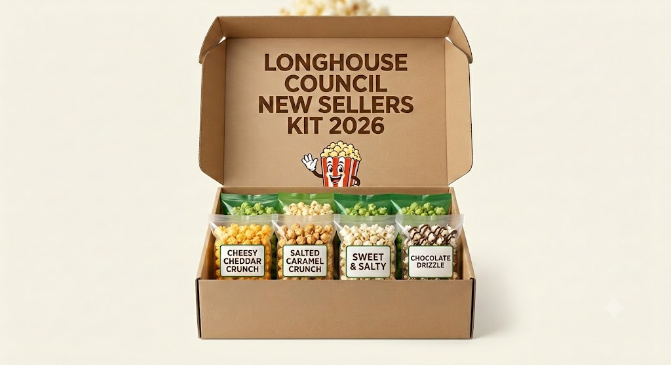

New sellers kit
If your unit didn’t sell last year, we have a deal for you! We’re going to give you $500 in a free product to get you started, risk-free!
To qualify and receive your kit, you must:
Commit to the sale by filling out the contract by September 1st.
Check in with your District Kernel/Professional at least every other week.
Order at least $500.00 in product, either Show-n-sell or take order.
*Kits are available only for the first 2 orders.*

Slide 11


Unit Kickoff
Make the event exclusive for Popcorn
Keep it exciting and interesting
Use your Taste Kit for the Scouts to try the product
Demonstrate effective sales techniques
Create a challenge with an End Goal

Slide 12

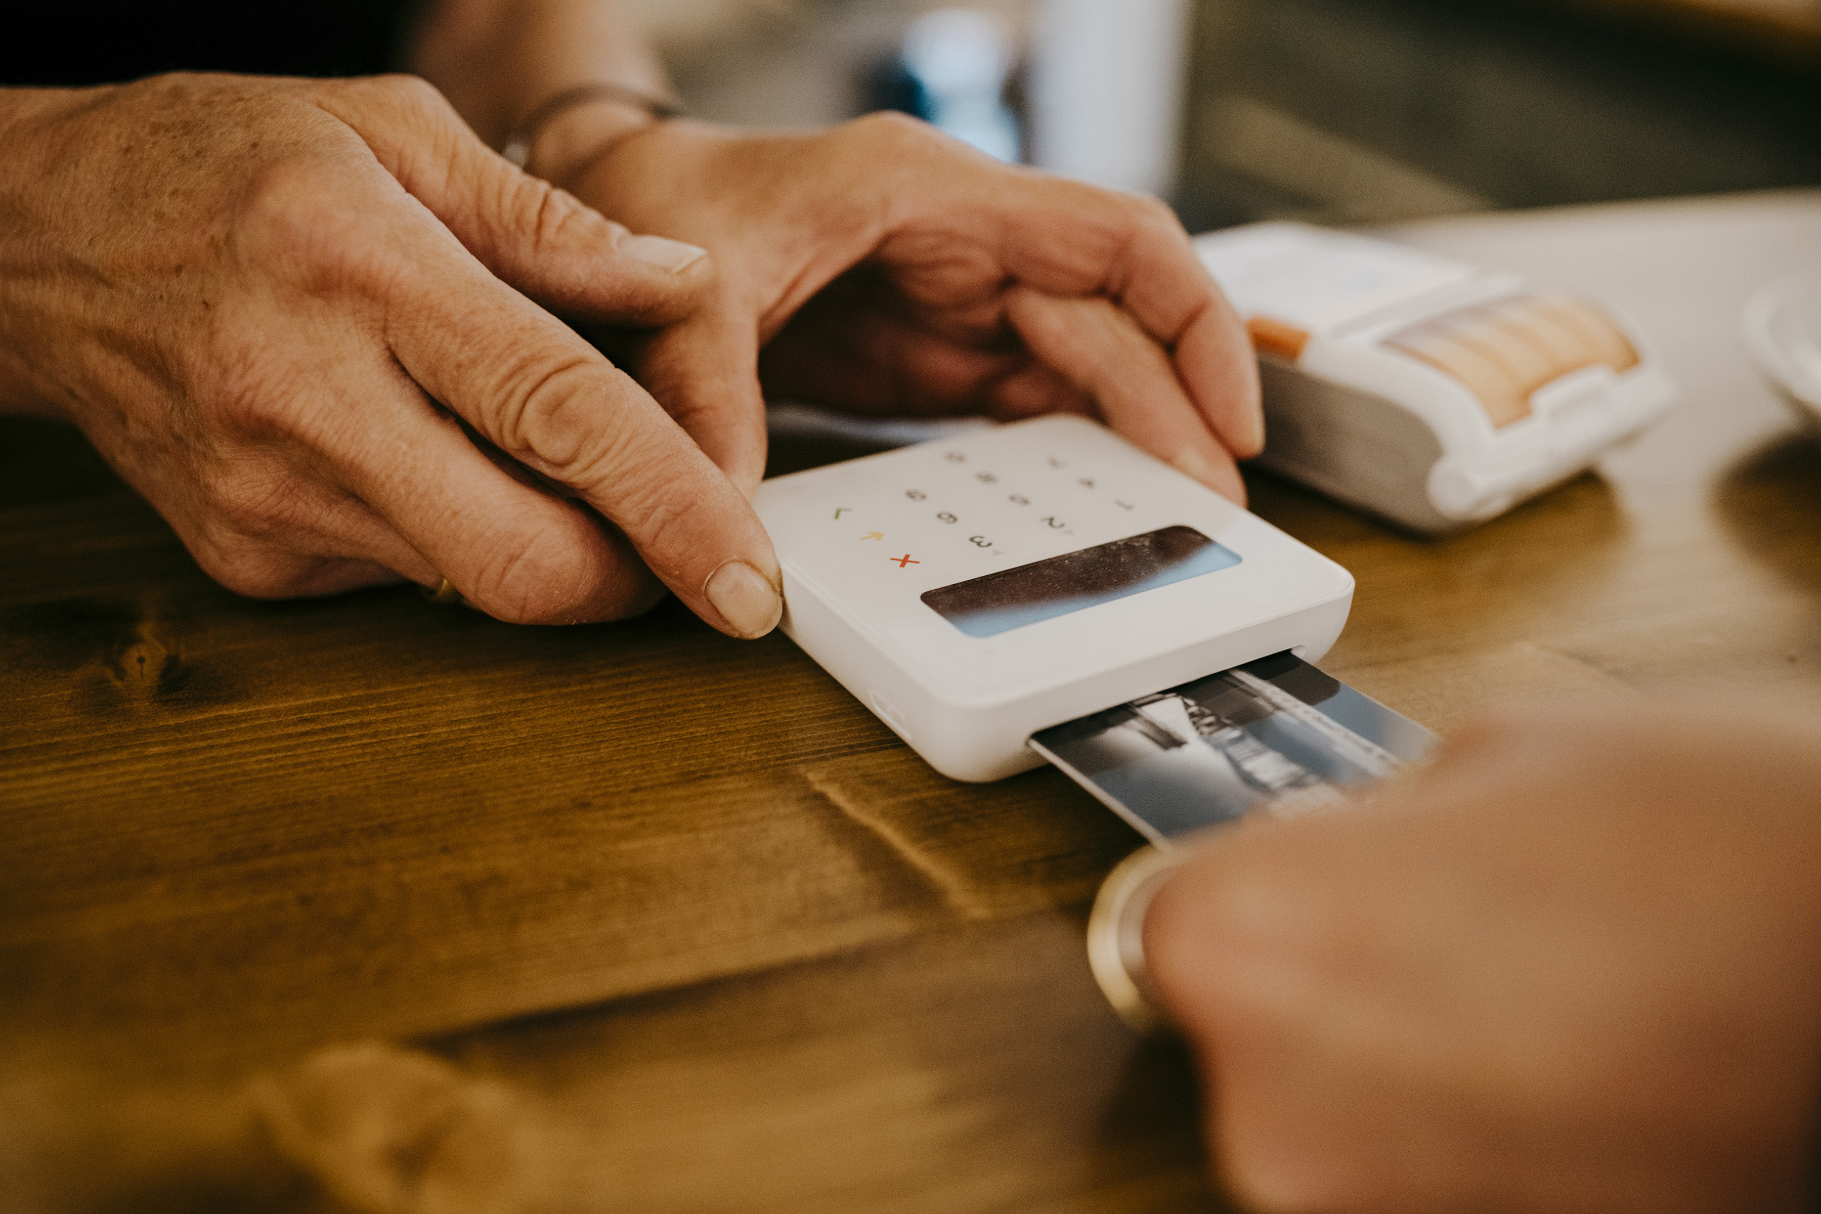

SALE OPTIONS
Online: Opens August 1st & closes November 28th
Show & Sell: The Early Bird order is due August 5th, pick up is August 28th
Booth: You should be reserving and confirming your locations now.
Wagon: It is still a very productive method.
Take Order: Start when you receive your order forms.
PAYMENT OPTIONS
Cash
Credit Card
Venmo/PayPal

Slide 13


Kernel survival techniques
Start Small
Recruit Help
Use our Resources
Ask Questions
Set a goal and give weekly updates

Slide 14

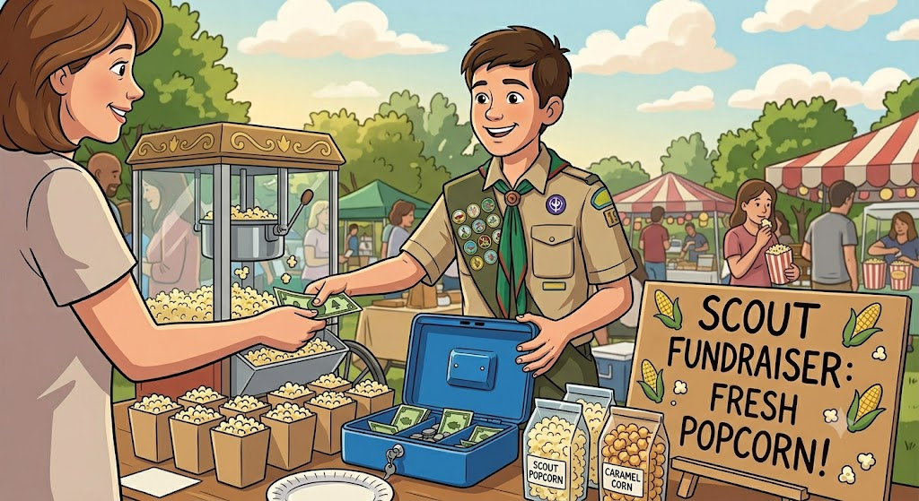
Popcorn kits
Contact your District Professional.
Tell them you want to sign out a Kit!
We have 3 Kits to choose from.
$650 Kit earns your Scout $214.50
$1350 Kit earns your Scout $445.50
$2600 Kit earns your Scout $858.00
*This is a no-risk ALL-REWARD program; you only pay for what you sell*

Slide 15
Proven methods for success
1. Consider your Scouts’ ages when scheduling, for most, 2 hours is max
2. Anticipate common questions
3. Rehearse your responses
4. Arrive Early
  * If you are on the first shift, please arrive early enough to set up the table and begin selling when your shift starts.
Scouts must have an adult with them at all times.
(Adults need to handle the money and track what is sold)
– Please be aware that you cannot leave the money and popcorn without an adult
Supervision-even for a quick bathroom break. There have been units in our area have been victims of theft at show and sells and we don't want this to happen to anyone else!

Slide 16
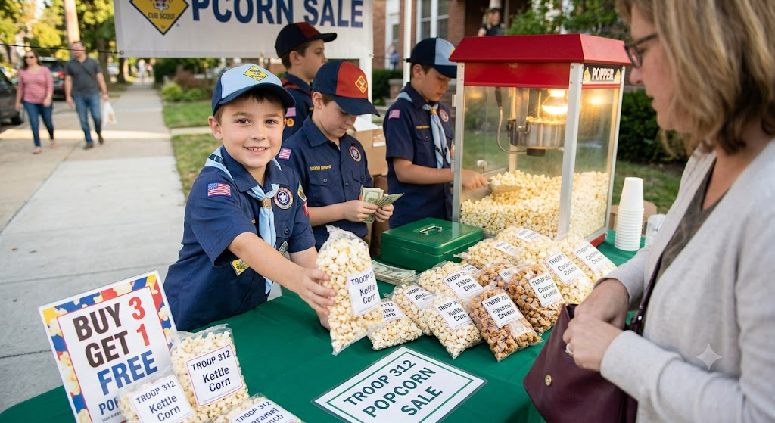
Methods for success
Scouts should be in FULL uniform.
Coach your Scouts to smile when talking with customers and make sure to practice your script ahead of time.
Ask customers to support Scouting, not to buy popcorn.
Be respectful to the stores/public places where you sell. Leave it better than how you found it.
Having information about your unit & other local units, flyers, pictures, applications, and contact information is great to have handy!

Slide 17

Scout Incentives
Club | What | Prize | when
650 | 3 Weekly drawings on Friday | $20.00 Gift Card | Starting Sept. 12th
1500 | Sell more than $1500 | The Dino Bounce-o-ree | January
Winner’s Circle | Scouts sell $3000 | See Flyer | December/January
Top 20 | The Top 20 Seller | $50 Gift Card | January
Papa Bear’s Challenge | The 2 Units: 1 Pack & 1Troop with the Highest % of Increase in sales (must have sold in 2025) | $150.00 Gift Card | January
CC BY-NC

Slide 18
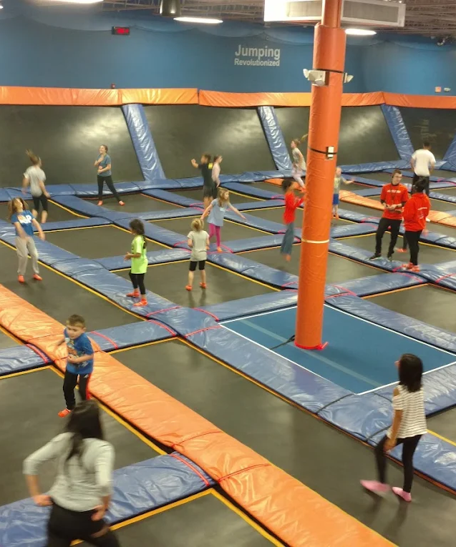
Dino bounce-o-ree
All Scouts who sell over $1500 in popcorn will be invited.
To be held at the Sky Zone
In early January
The top three sellers can invite a friend
There will also be a Last Chance spin for a Scout from the 650 Club.

Slide 19
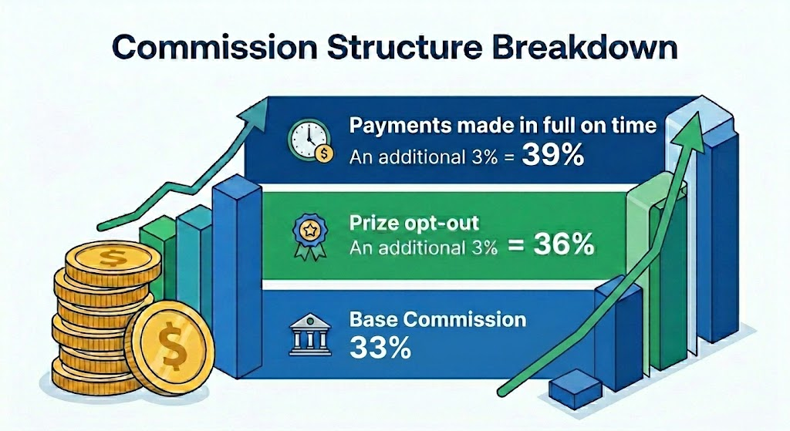


Slide 20
returns
• Returns are accepted by appointment ONLY Oct. 26 – 29th during normal business hours (9 am-5 pm) or by other arrangements with your District Professional. NO UNSCHEDULED DELIVERIES will be accepted.
• A unit may only return no more than 20% of its total order value. Products ordered by units through the online portal cannot be returned to Longhouse Council.
• Only UNOPENED and FULL cases of popcorn may be returned. The Longhouse Council reserves the right to refuse a damaged product.
• A product that has a factory/shipping defect must be returned when discovered, with pictures of the damage as well as the code on the packaging.
• Be sure to keep any items needed to fill your final order and return only the excess.
• When you return your product, bring along a list of items you’ll need for your final order. If your list is in stock, you won’t need to place a final order; you can take it home that day!
• You may transfer excess product to another unit that needs it. To find a unit that needs additional popcorn, join the “Longhouse Council Popcorn Swap” Facebook Group or talk to your District Kernel or District Professional.

Slide 21
Payments
Payment Due Dates:
Sept 23rd: 1st Payment, 20% of early bird order
Oct 14th: 2nd Payment, 20% of balance on account
Nov 11th: 3rd Payment, prior balance due (all show-n-sell) in full to receive the Take-order product.
Dec 11th: Final Payment; account balance
Dec 16th: Balance plus 2%
Dec 30th: Balance plus 5%
Jan 6th: Balance plus 10%, with 1% being added per day thereafter.
NO EXCEPTIONS

Slide 22

Country Meats Option
New this Fall
Show & Sell or Take Order
Order the product by the Case
Commission is 33% or pay in full upon receipt, and earn 35%
Sales count towards both the 650 & 1500 Clubs
NO RETURNS

Slide 23


Slide 24

Thank you!
+
You
Please help your Youth realize their dreams & potential

